Slide 1
Module 13
Authentication with HTTP

Slide 2
Objectives
The need for state in HTTP requests & responses
Authentication with username & passwords
Introduction to tokens and cookies
Hashing passwords in the database

Slide 3
Recap
We’ve understood the basics of how a webapp works
We’ve understood the client-server architecture
We’ve build a basic webapp and know how frontend & backend code works
We’ve understood the need for a database to store state

Slide 4
HTTP is a stateless protocol
One HTTP request made by the browser actually has nothing to do with another HTTP request
From the server’s point of view, both are completely independent requests
To make each request
An HTTP connection is opened
A URL, headers, and request body (if required) is sent
The server responds with an HTTP response: status_code, headers and response body
The HTTP connection is closed

Slide 5
Problem: How do I login to a site, and then stay logged in?
If every HTTP request is independent, how does a user ‘stay logged in’.
For eg:
Login into gmail
Make API requests to fetch your email data, compose emails etc
After logging in, how does the server know if subsequent API requests are made by the same user?

Slide 6
Problem: How do I login to a site, and then stay logged in?
Login as user90: username/password
Browser
Gmail server
1
Save username + password to compare
Login successful
Gmail database
Fetch emails
2
Whose emails?

Slide 7
HTTP is a stateless protocol
Because HTTP is stateless (meaning no state is shared between 2 requests) how does the server know the identity of the second request?
Answer:
Make the server send a secret, unguessable random string
Called a session token
Client side JS of the webapp should use this session token every time while making a request

Slide 8
Problem: How do I login to a site, and then stay logged in?
Login as user90: username/password
Browser
Gmail server
1
super-secret-token
Gmail database
Fetch emails +
super-secret-token
super-secret-token <==> user90
2
user90’s emails

Slide 9
Sessions
A session ID, or a session token is generated by the server and needs to be sent along with every request
If any session ID is lost, then a hacker can make requests pretending to the server that the hacker is userid90 with the right session ID
Make the server send a secret, unguessable random string
Called a session token
Client side JS of the webapp should use this session token every time while making a request
Whether API request or a request for a page

Slide 10
How do we send this secret token?
However you want!
Options:
As a GET parameter
As a part of the request body
The standar way to do it:
Header (Authorization, Authentication)

Slide 11
Sending the session token:
Browser
GET http://server.com/emails?token=<>
POST http://server.com/emails {“token”: <token>}
http://server.com/emails [Authorization: Bearer <token>]
Gmail server
Gmail database
Any authorized request +
super-secret-token
Response appropriate to user

Slide 12
But we need to send the token manually with every single request!
So the browser has something called cookies
Cookies are special HTTP headers, that once set, the browser will keep sending along with every request to that server
Cookies are tied to a specific domain
Cookies have an expiry
A server can request the client to set a cookie with a particular name and value
The client may or may not decide to respect that
If the client does agree, then it sends a cookie header that contains the name and value

Slide 13
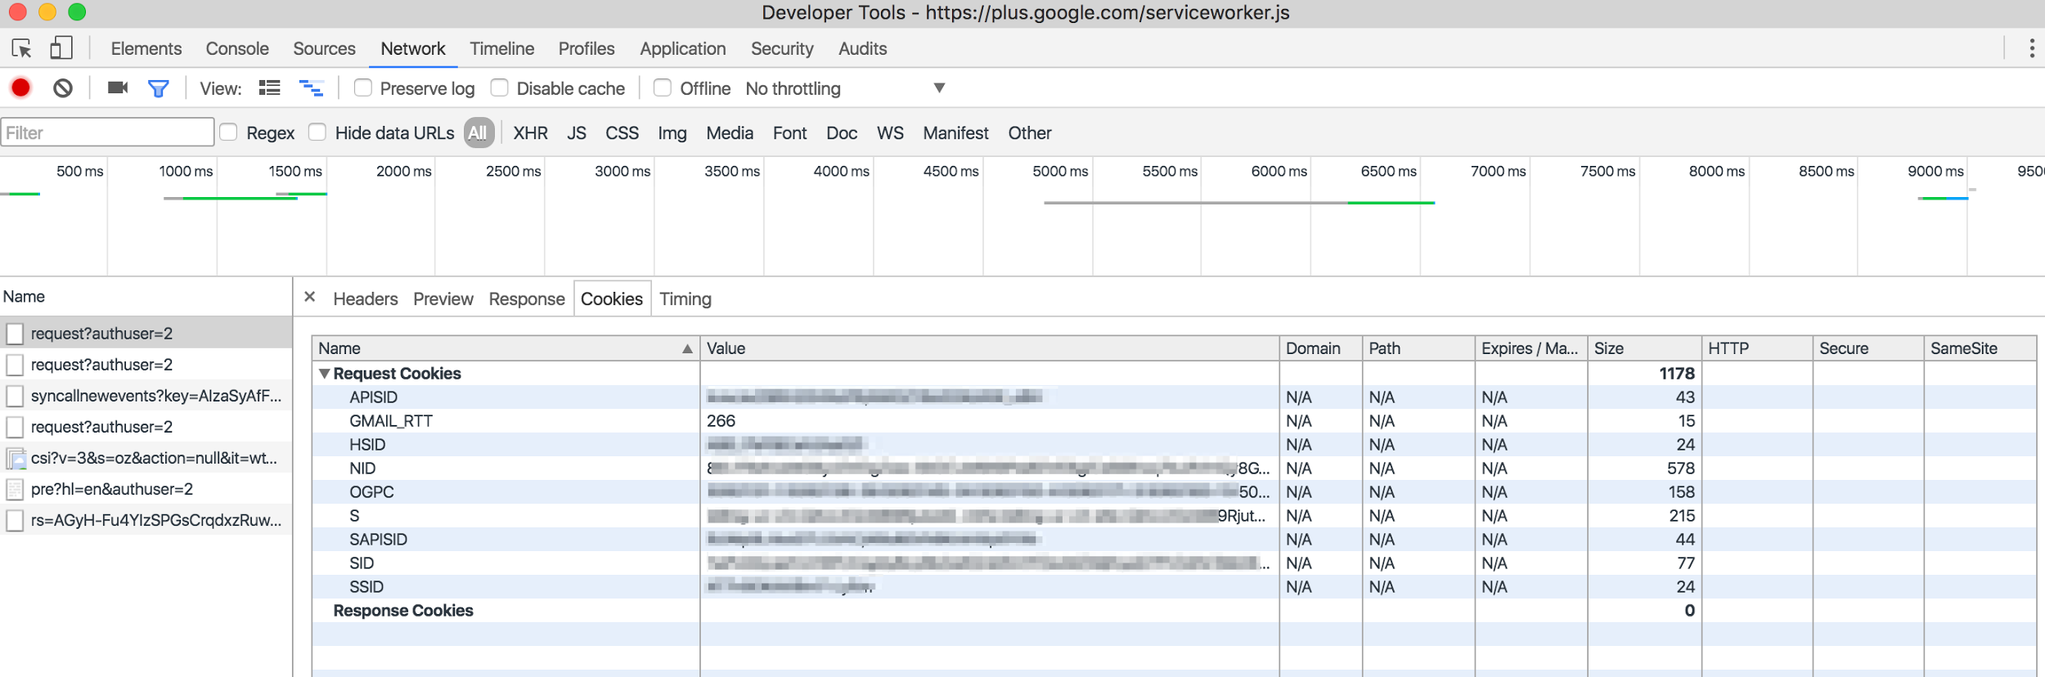
Examples:
Go to any site where you’ve logged in > Inspect Element > Network tab > Request > Cookies tab

Slide 14
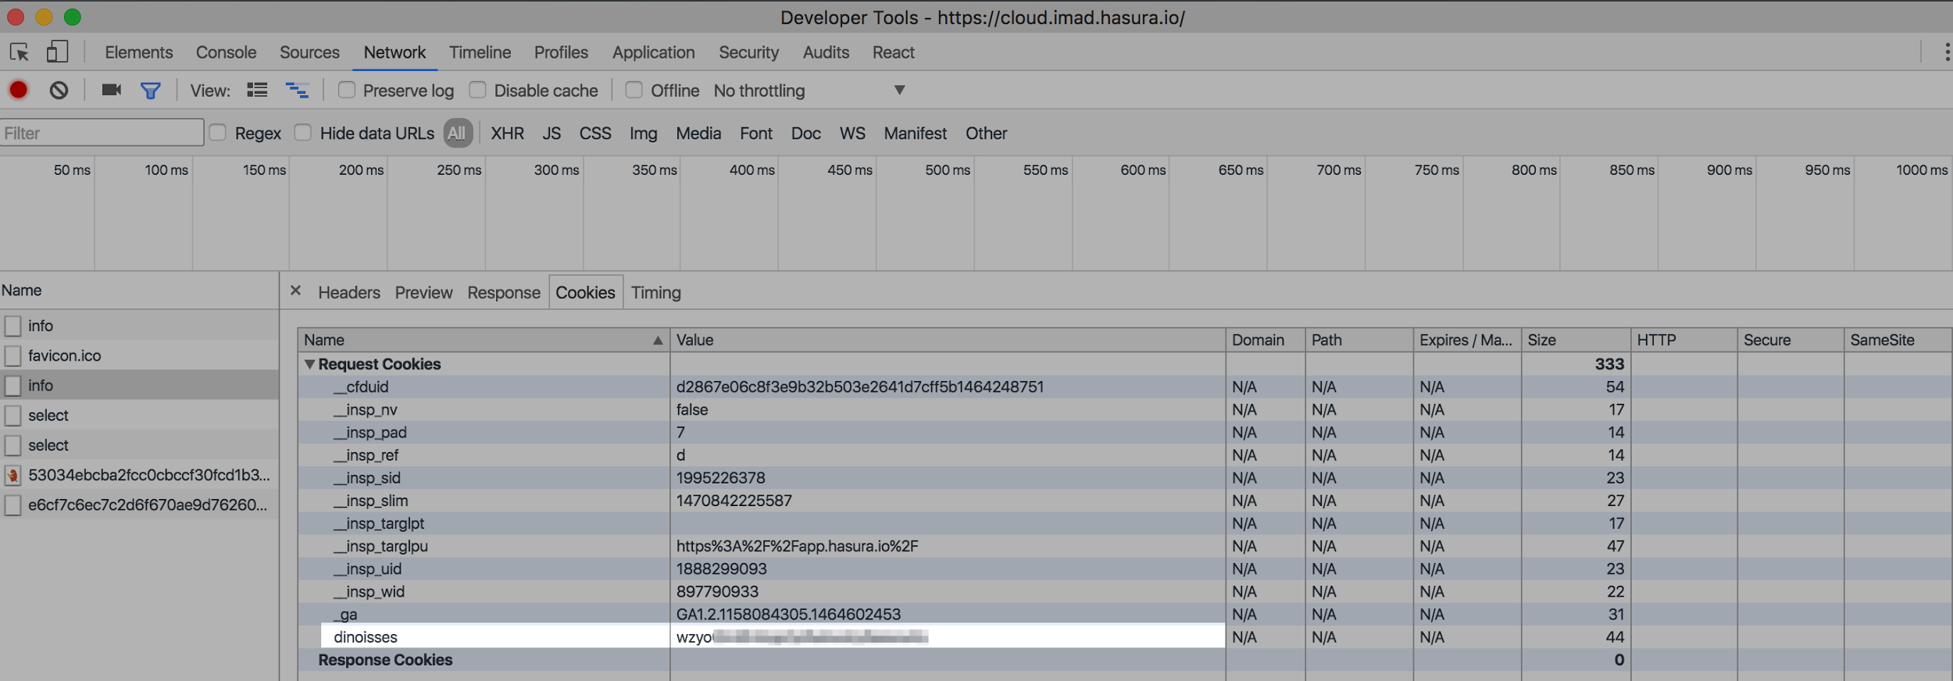
Examples:
Go to any site where you’ve logged in > Inspect Element > Network tab > Request > Cookies tab

Slide 15
Cookies
So cookies are pieces of data that are automatically attached to any request made to the same domain
This makes them useful for all kinds of other things apart from just authentication tokens
Tracking
When you go to a webapp and it remembers what you did, even if you didn’t login
Cookies can be set by the server
Cookies can be set by the client side javascript
Cookies are completely under the control of the client (the browser)

Slide 16
Storing usernames/passwords
In our database, we need to store the username/password so that in a login request we can verify if someone has entered the right username/password
username | password
user1 | myPassw0rd
user2 | myN3wP4ss
But now anyone who can see this table’s data (say a hacker gets access to some data from this table), then the hacker can just use the password and pretend to be user1!

Slide 17
Securely storing usernames/passwords
Passwords can be hashed
A Hash is a function that converts any string into an utterly random fixed length string
myPassw0rd ⇔ a3qadcasdf1231sdfzfnaskxjzzdf
Hashes are amazing mathematical functions because it is extremely hard to convert that random string back into the original text. A one-way function.
Hashes are amazing because the probability of two pieces of text having the same hash value is extremely low
username | password-hash
user1 | asasdf2j039...
user2 | kjkuer923ca...
So now, instead of passwords store password hashes
When a login request is made, compare hashes not the raw password
If a hacker gets access to the password hash, nothing to be worried about.

Slide 18
Key takeaways
HTTP is a stateless protocol
Extra data needs to be sent that can help tie multiple HTTP requests to the same context
A session token is used for maintaining a login session
A session token can be sent in any manner as the developer chooses
Best practice to send it as an Authorization header or as a cookie
Cookies are pieces of data that are automatically attached to every HTTP request made to a server
Passwords are hashed and stored in the database, otherwise extremely insecure!

